Slide 1

Innovision
Fontys ICT SEMESTER 3

Slide 2
ABOUT US
We are Team Innovision. We are the team responsible for creating instructions for the lights in the media lab. With our help, you will become a pro at setting up the lights however you want.

Slide 3
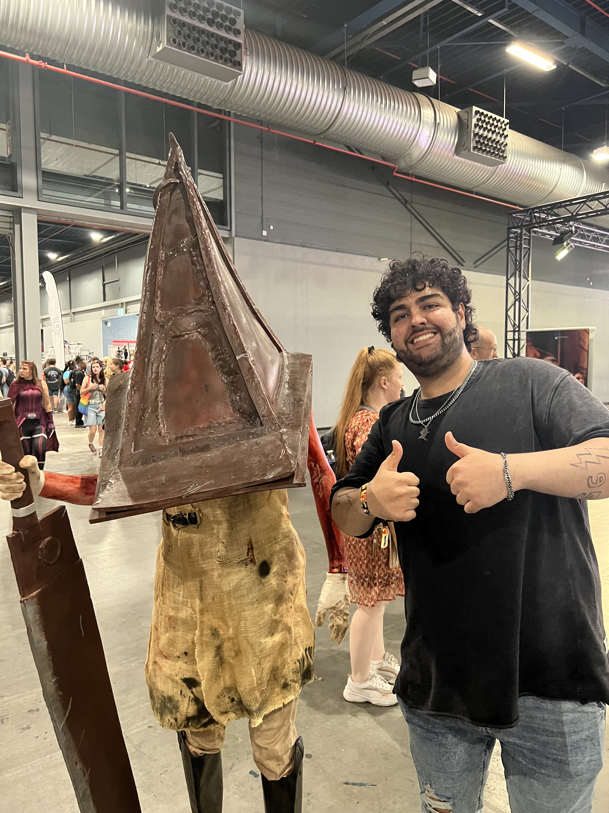
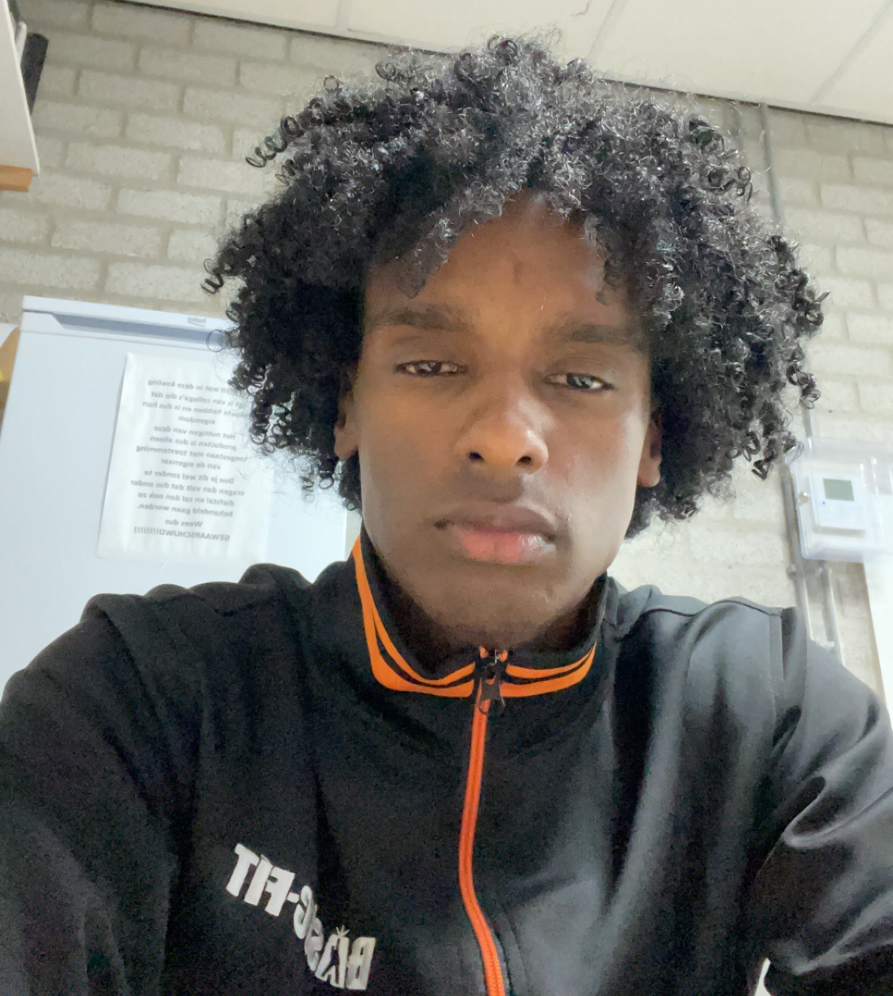
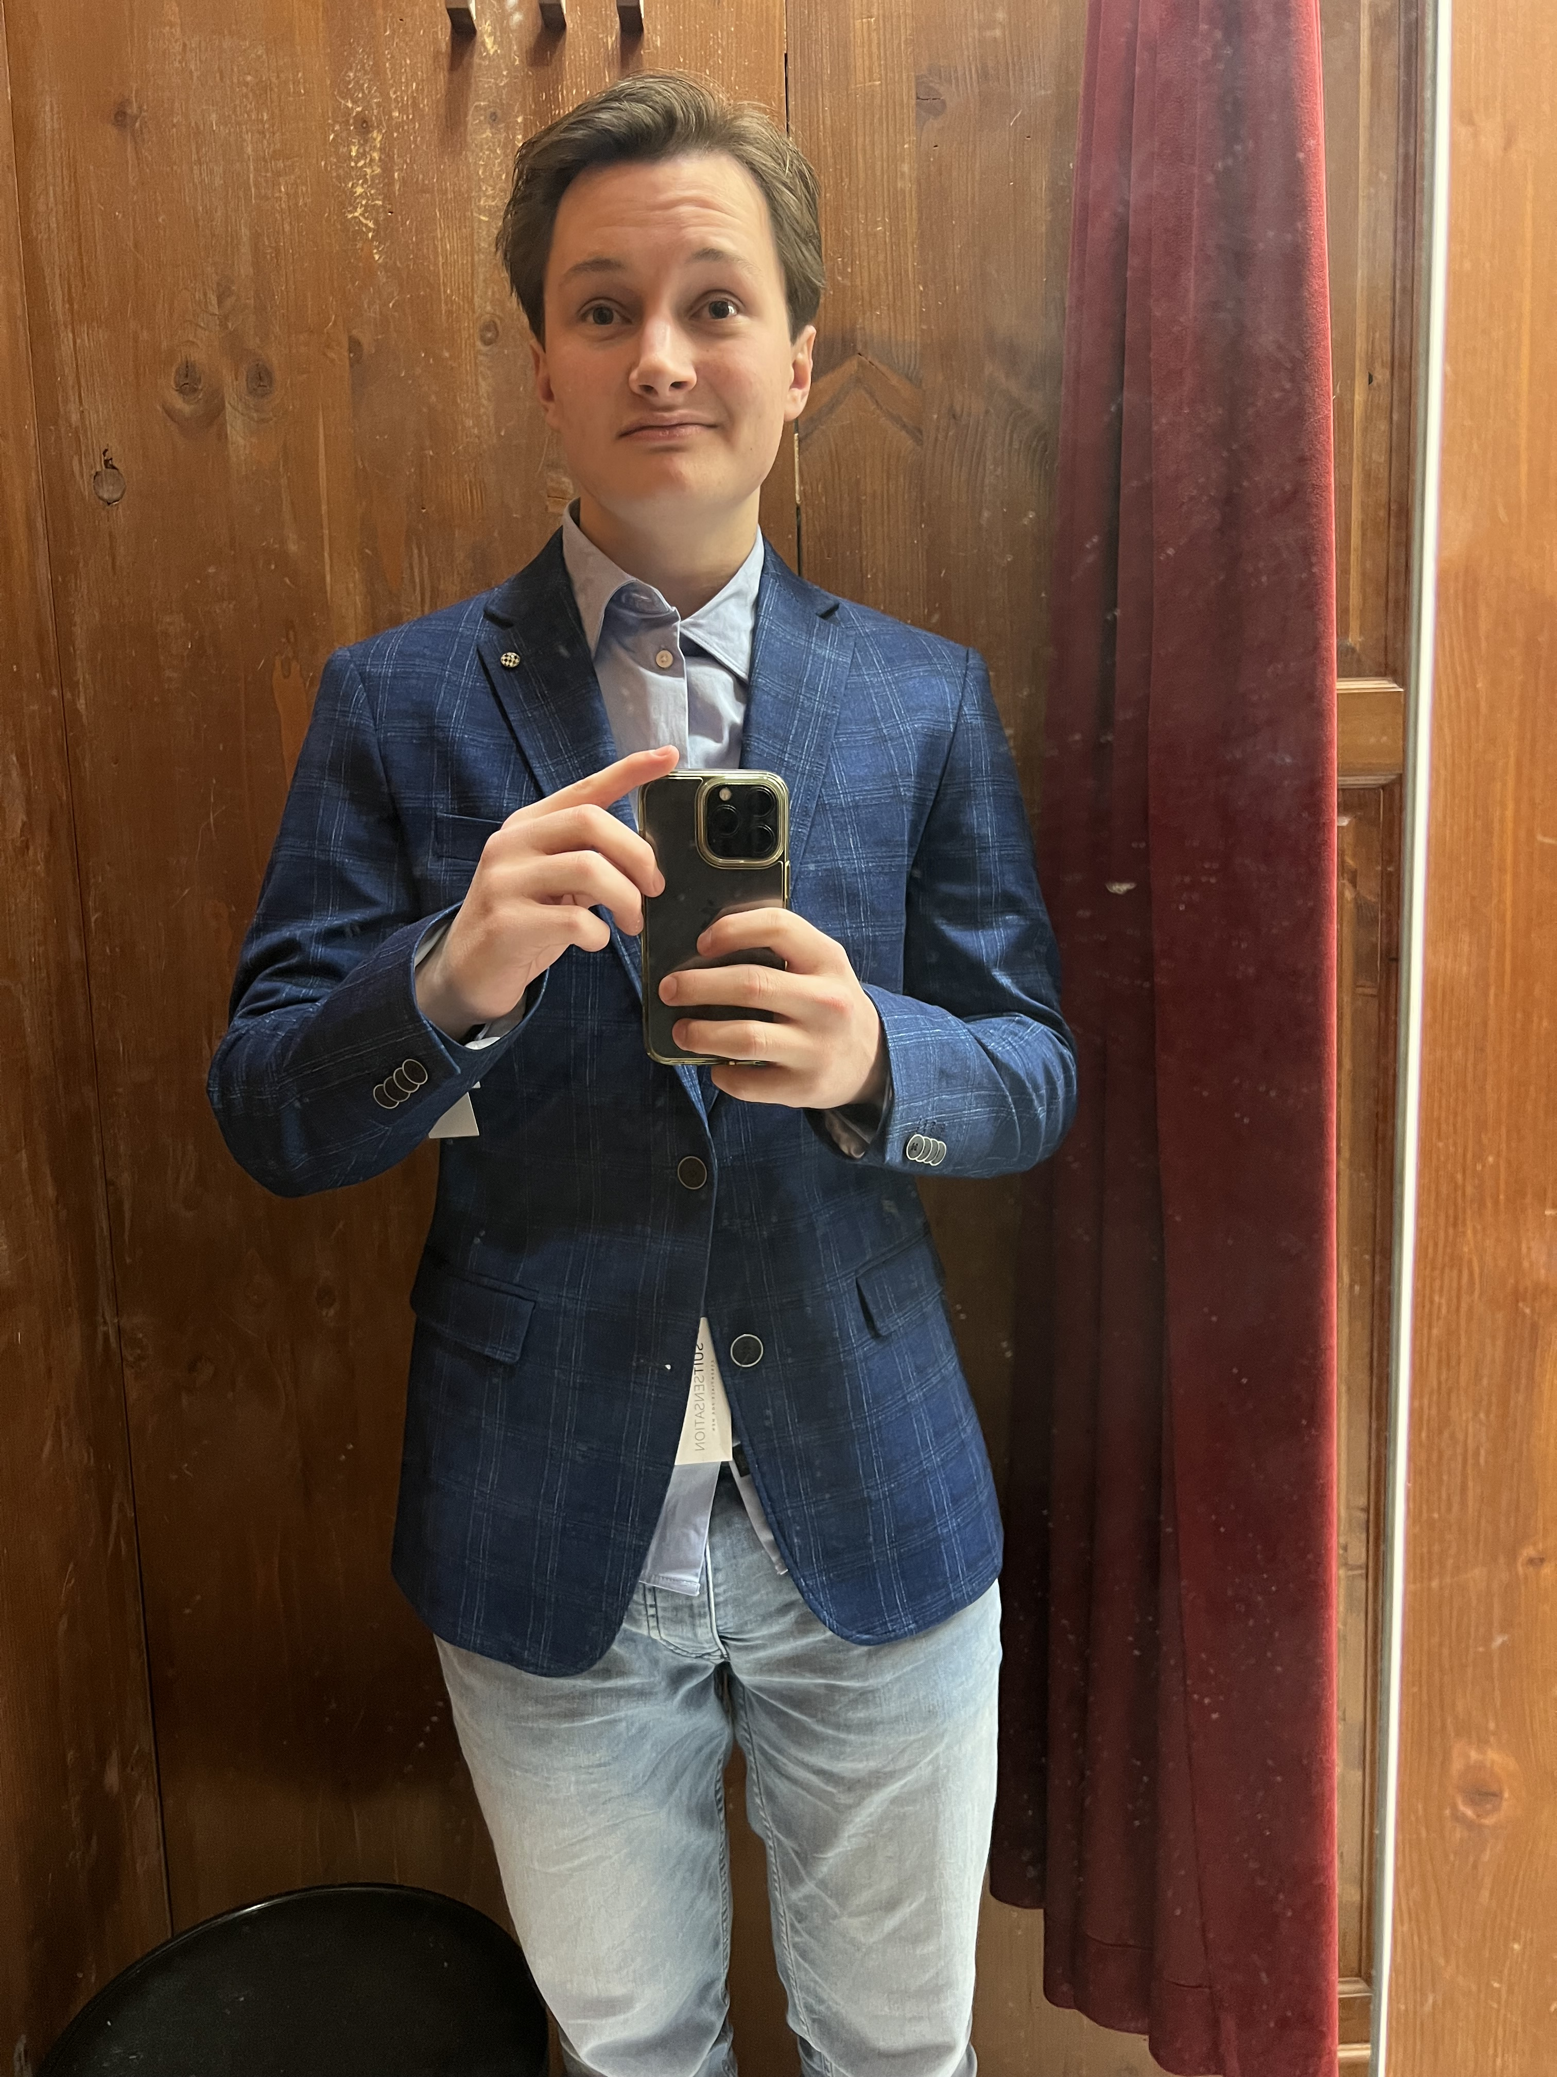
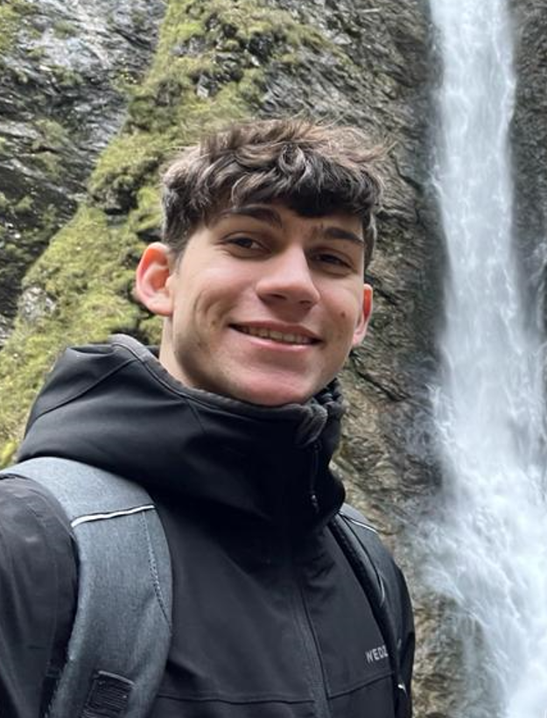
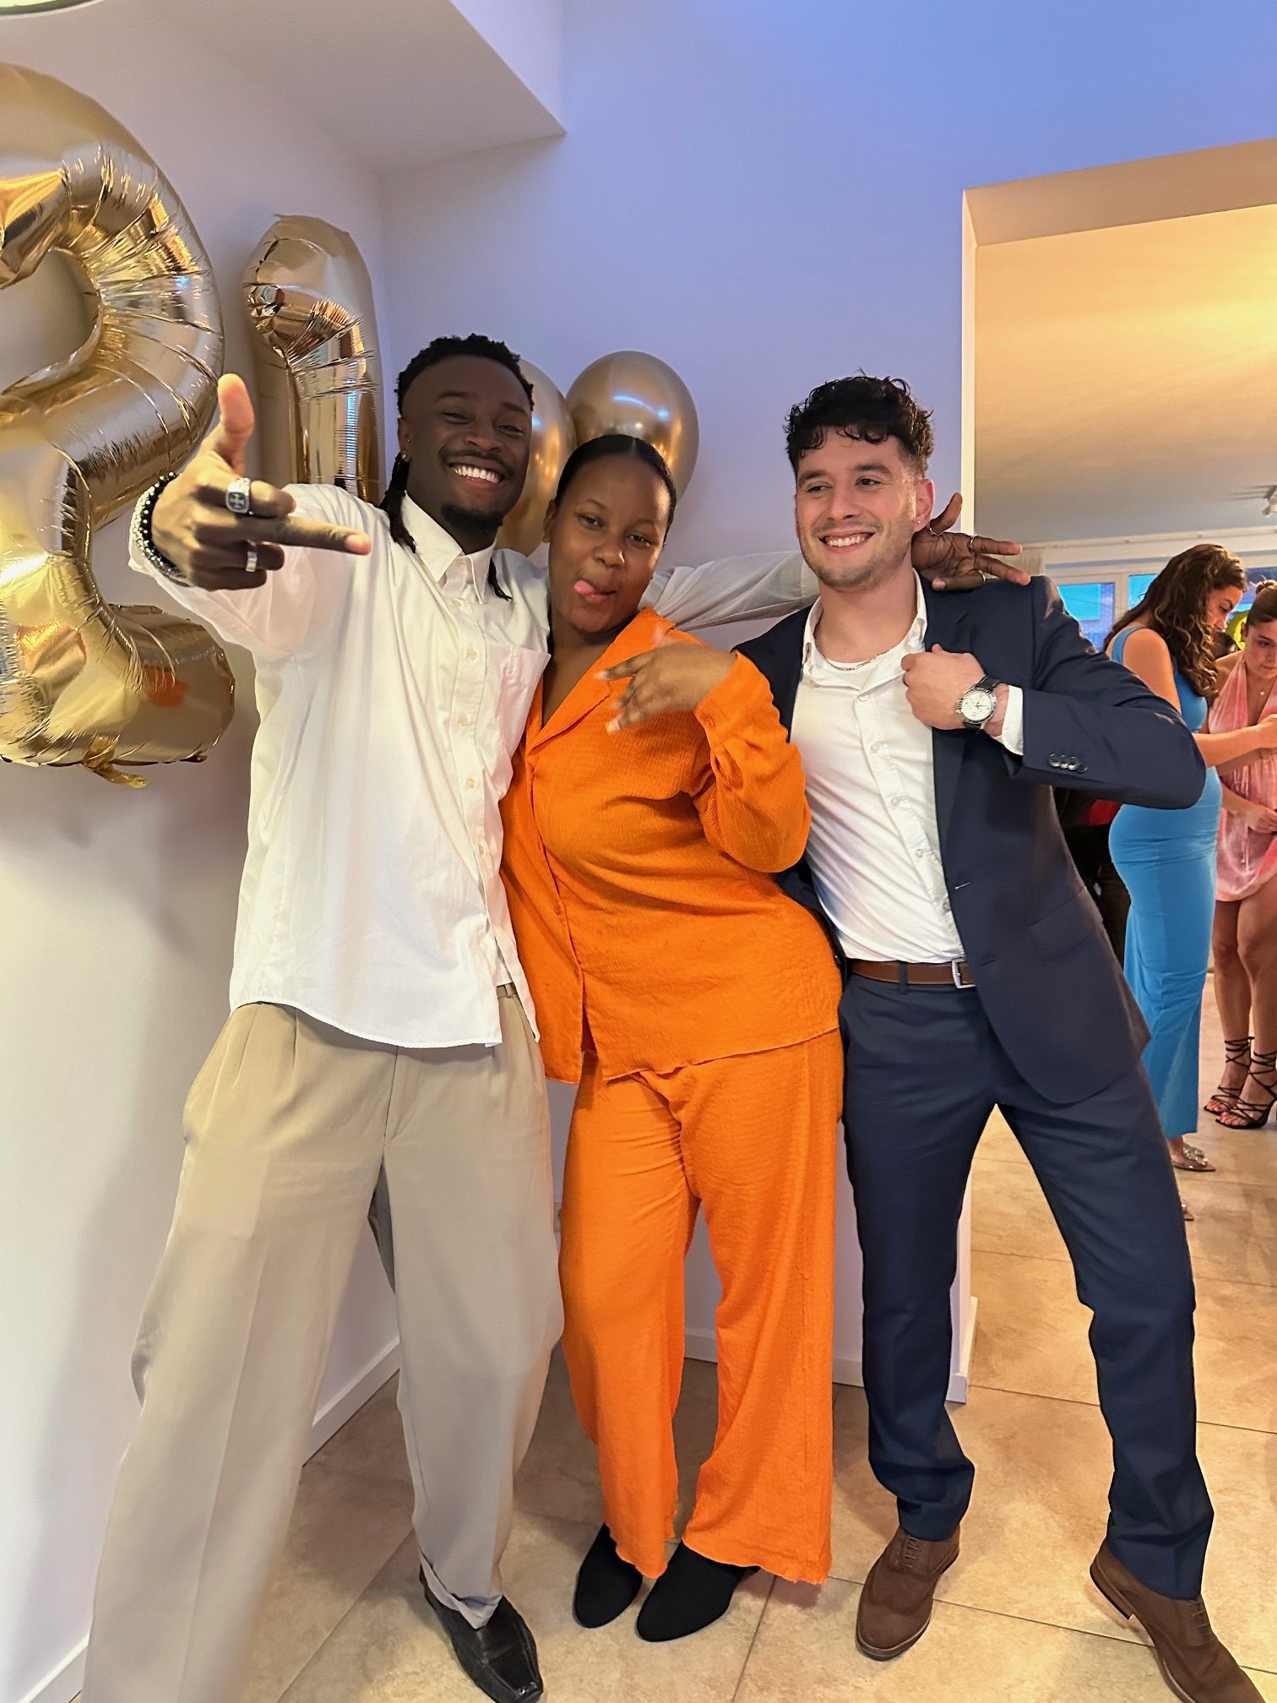

MEET THE TEAM
Sina Sharifi
Zacharia Abdi
Owen Sevriens
UI Specialist
President
Administrator
Lewis Cardona
Kyle Osei
Vice-President
Creative manager

Slide 4
Table of contents
Problem statement
The new media lab is too difficult for users to navigate without guidance.
Solution
Creating easy to follow instructions for everyone to follow
Conclusion
An overview of the project and what's to come

Slide 5
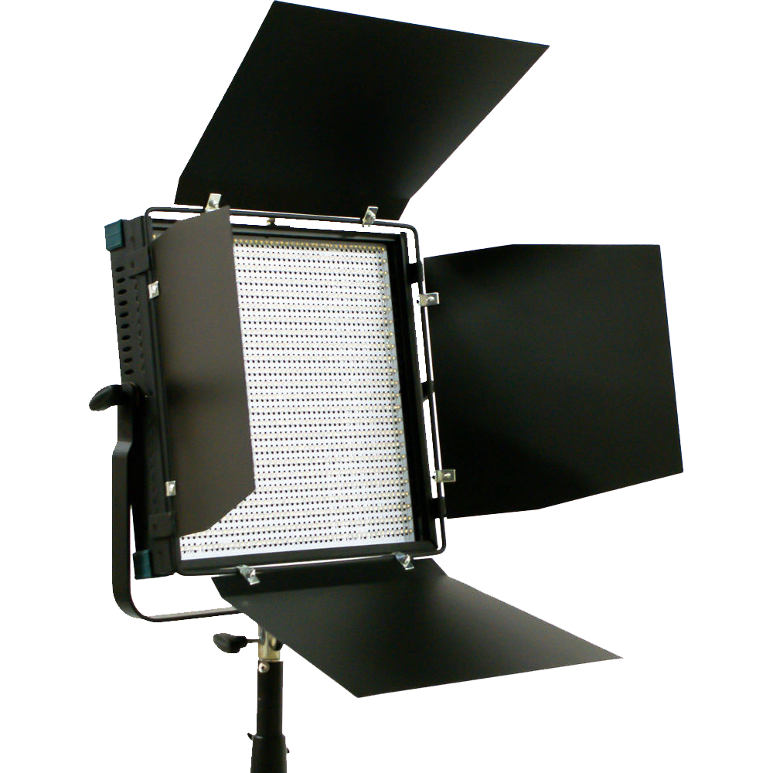
Understanding why Professional Lighting is Important
Elevates Visual Quality
Professional lighting enhances the quality of your work, making it visually stunning and attention-grabbing.
Sets the Mood and Atmosphere
It allows you to create the perfect atmosphere for your project, engaging your audience on a deeper level.
Boosts Efficiency and durability
By understanding how the equipment works, will boost your productivity and the lifespan of the devices.
Notes:
Owen

Slide 6
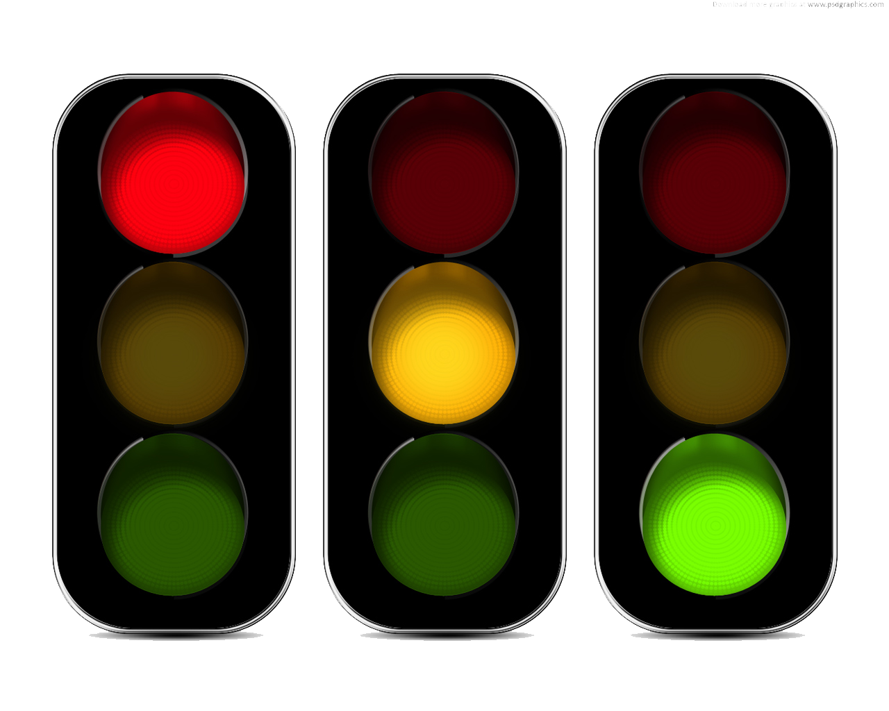
Problem statement
"The new media lab lighting equipment is too difficult for users to navigate without guidance. This poses a problem as it hinders their ability to make the most of the lab's resources."
OUR TARGET AUDIENCE
NO EARLIER INSTRUCTIONS
COULD BECOME EXPENSIVE
A SOLUTION IS NEEDED
Notes:
Louis
"The new media lab is too difficult for users to navigate without guidance. This poses a problem as it hinders their ability to make the most of the lab's resources.

Slide 7
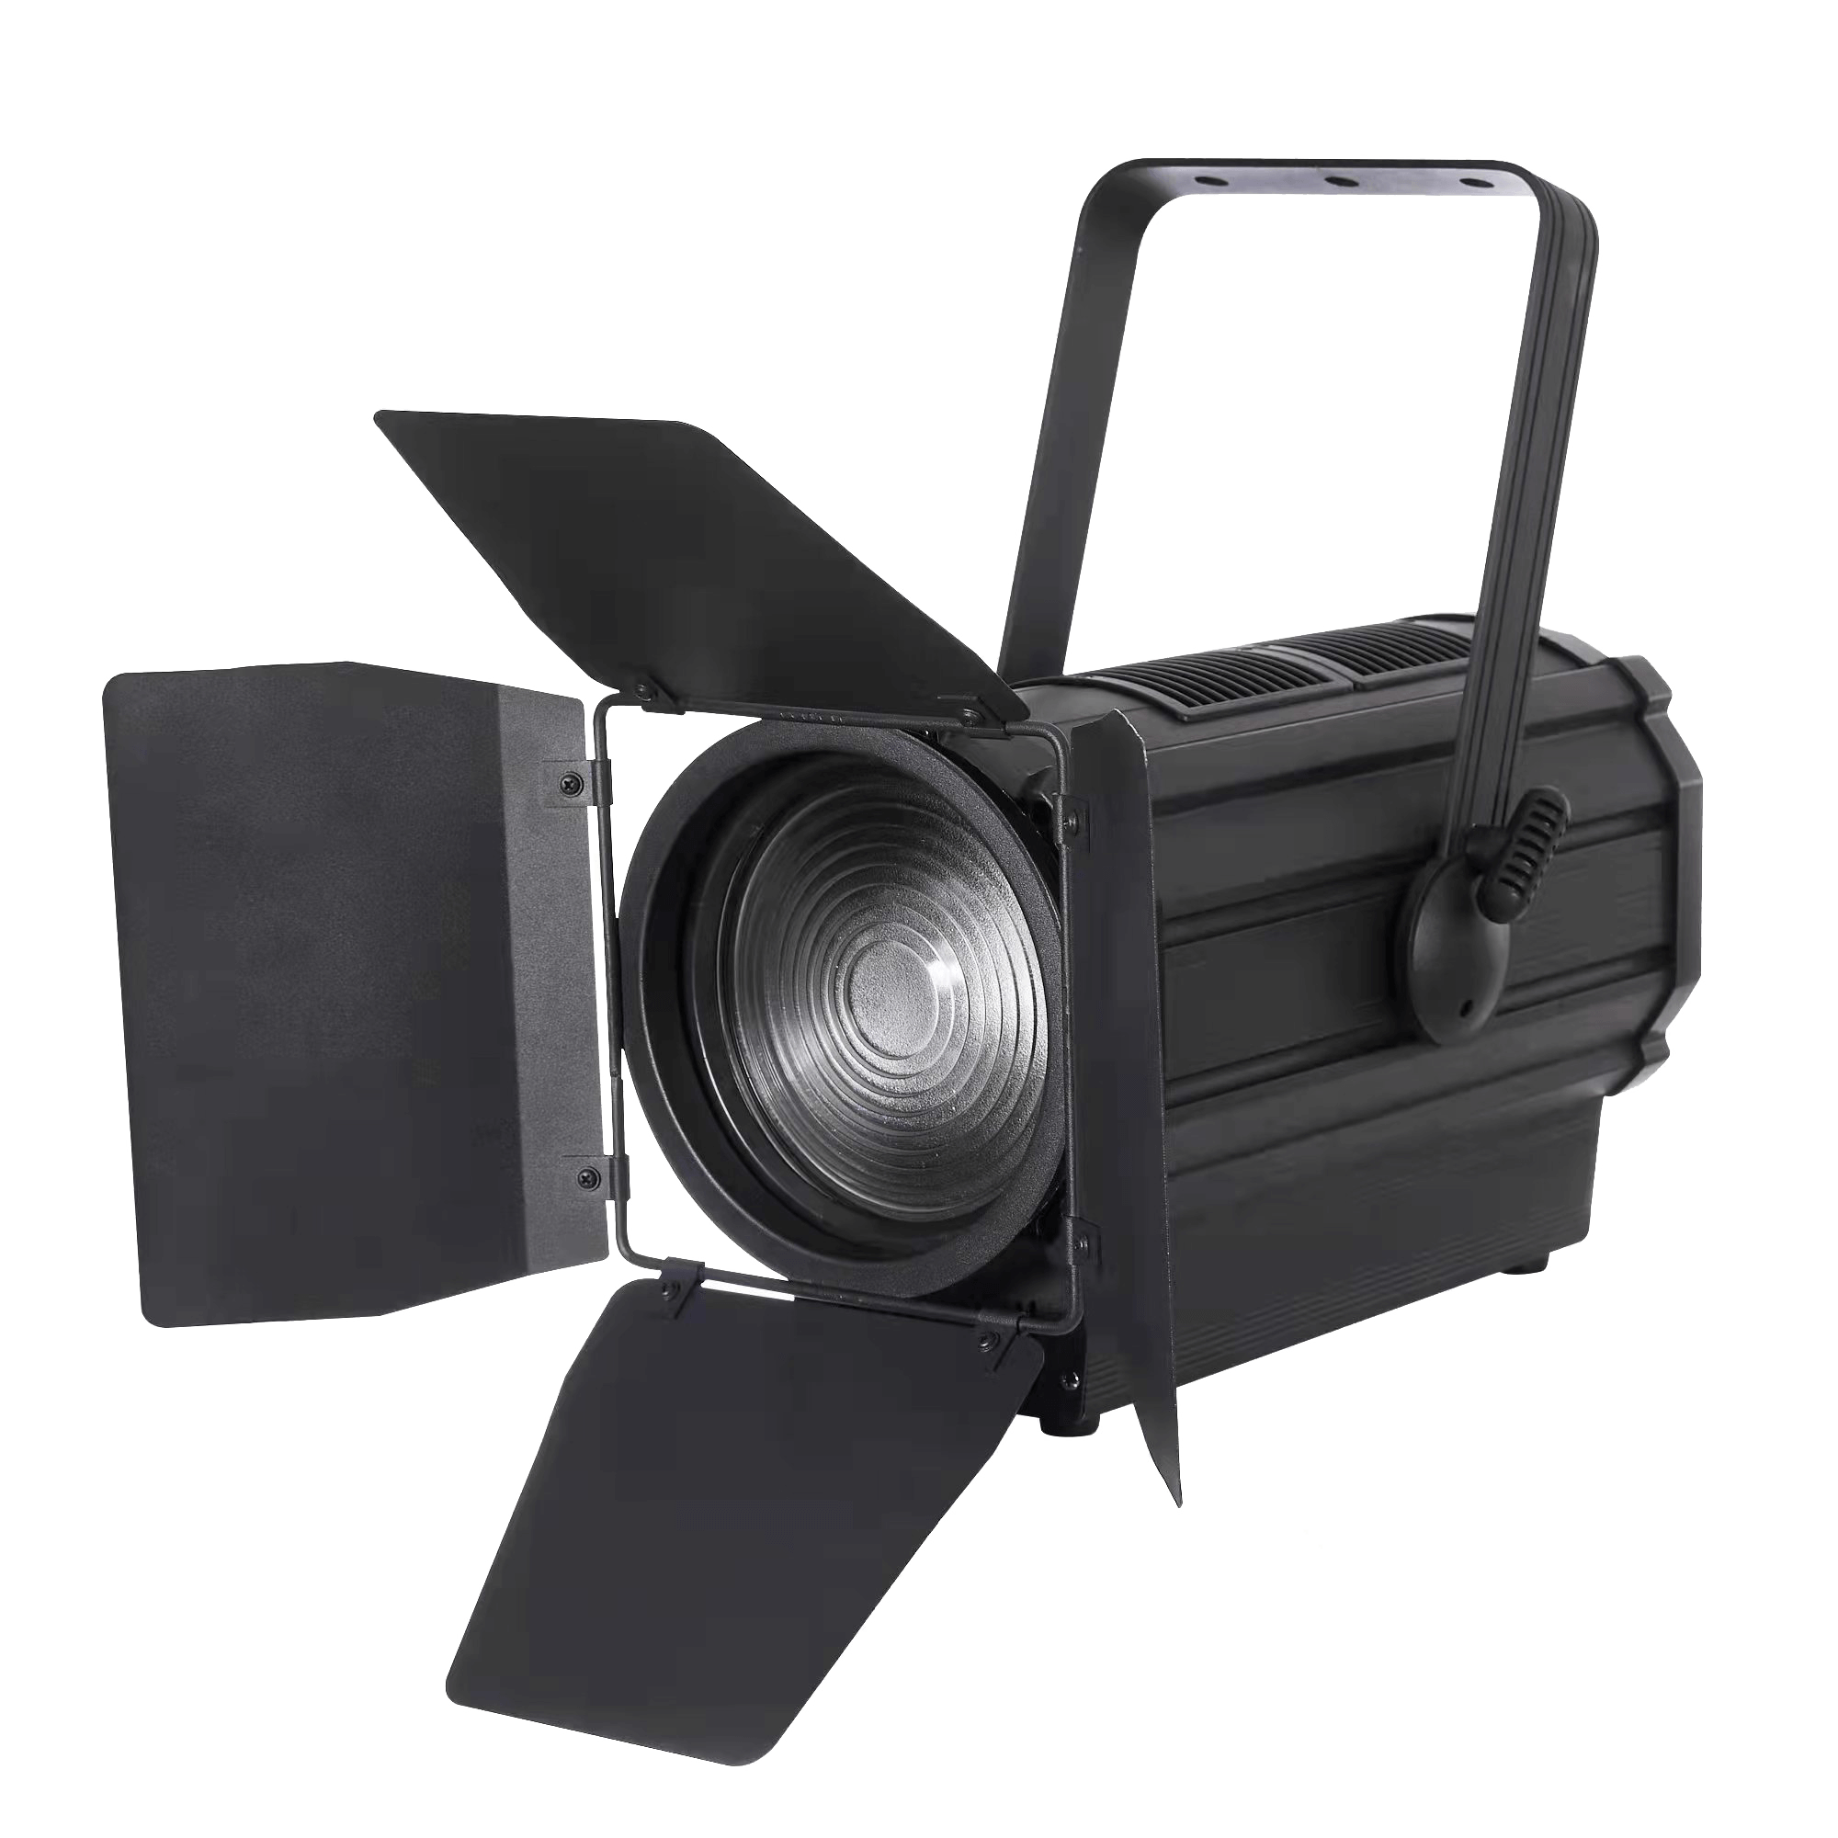
Solution
A solution to the problems that were stated earlier, are short tutorial video’s that the users could easily follow.
These videos try to prevent the students from breaking any light equipment, and it makes them more aware of how expensive these light sources are.

Slide 8
31 people have answered our survey
70% of the people haven't used the lights in the Videolab so we will make a few instructions the users could follow to prevent any damages to the expensive light sources.
66.7% prefer tutorial videos with voiceovers, so we will be creating content in line with their preference.

Slide 9
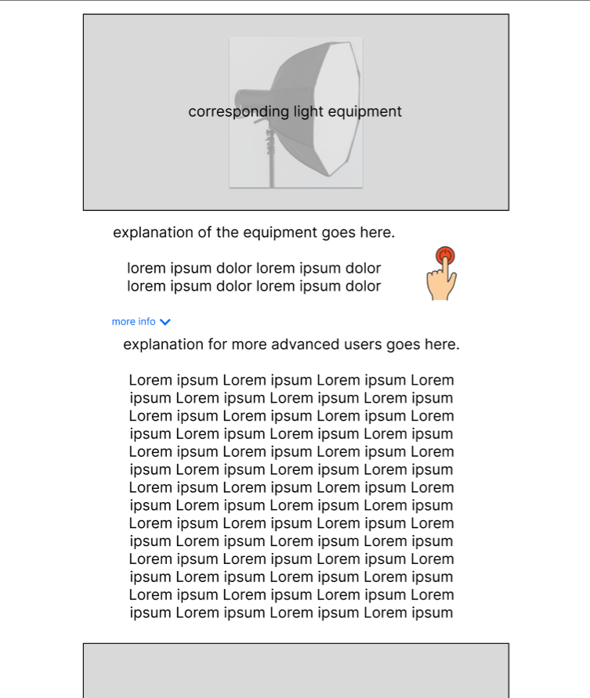
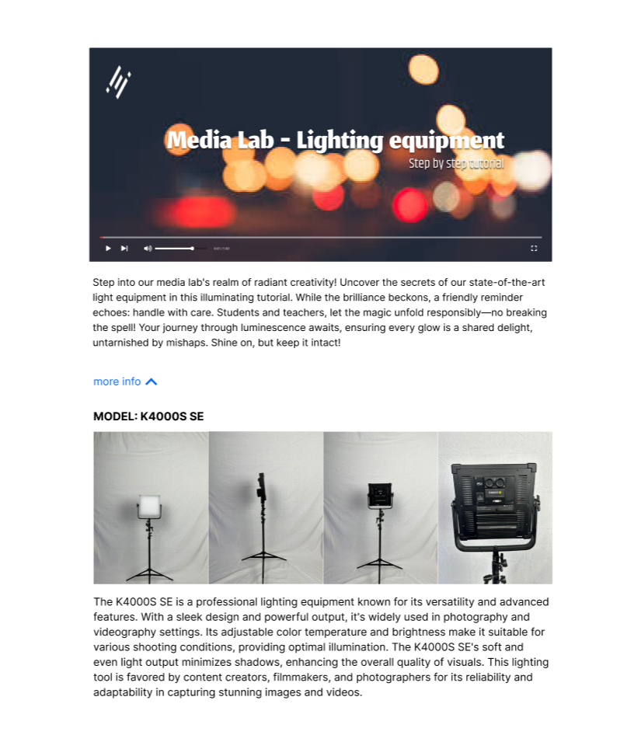

Low & high fidelity prototypes

Slide 10
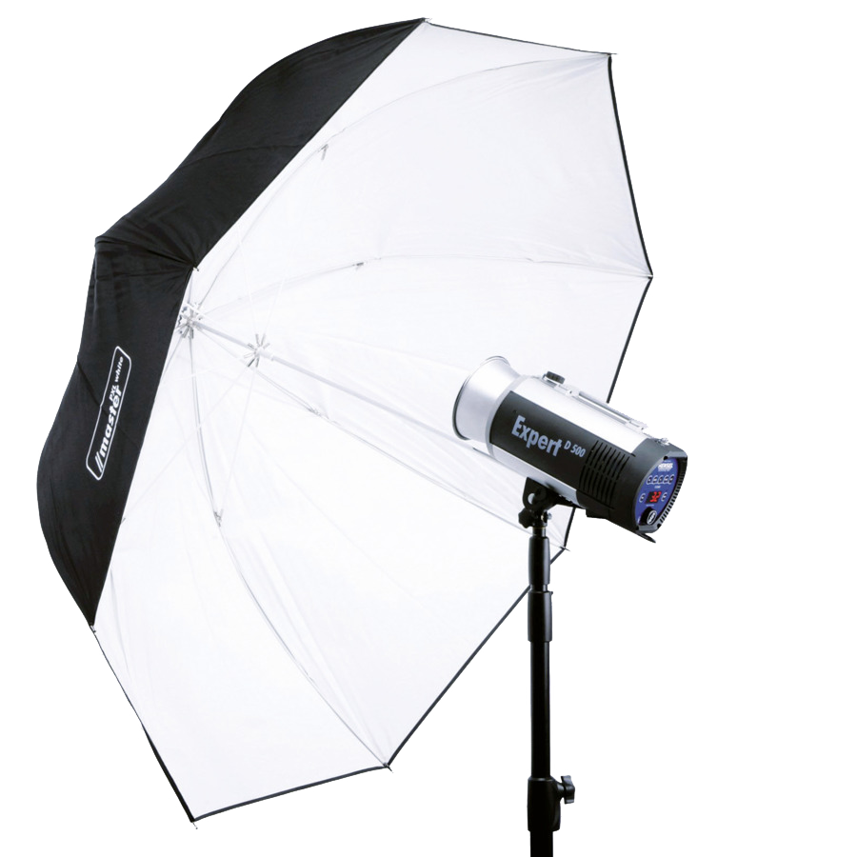
Conclusion
For months, students haven’t been able to use the lights properly, and this could cause damage. Therefore, we will provide video instructions.

Slide 11
THANK YOU
Sincerly team Innovision

